Slide 1
Lecture 5 Introduction to Machine Learning ⇨ Image and Video Processing
András Lőrincz
Department of Artificial Intelligence
Faculty of Informatics

Slide 2
Content
Image is two dimensional
Fast template matching in 2D
Convolutional networks
Training instead of design
Typical layers: Convolutional, Pooling, Fully connected,
Other things: Non-linearities, Losses
Many potential applications
But: those networks have more complex architecture
But: many of those wonders can be downloaded

Slide 3
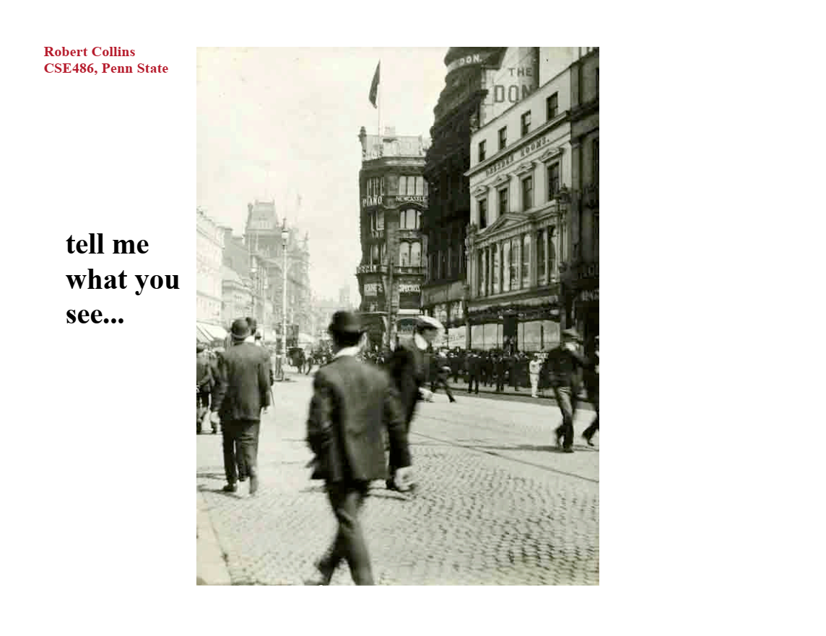

Slide 4
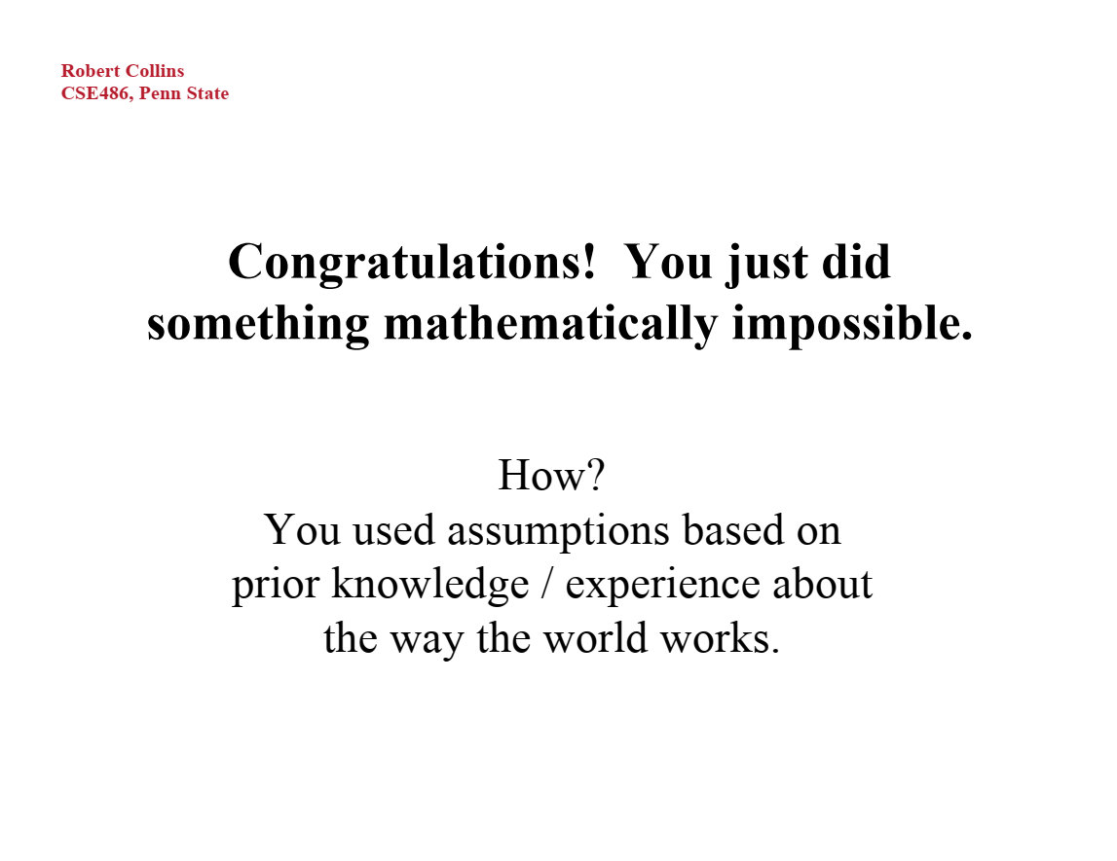

Slide 5
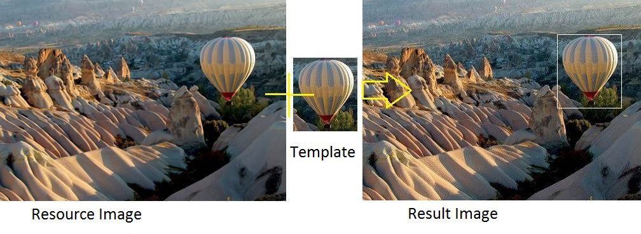
What is on the image?
Template matching...
Would you like to search for all possible objects?
Can you?
Source Image Target Image

Slide 6
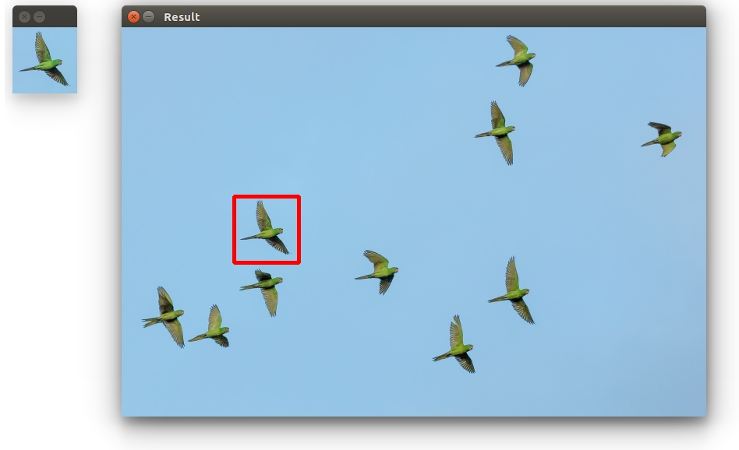
Template matching
Every object is to be searched everywhere
Source Image Target Image

Slide 7
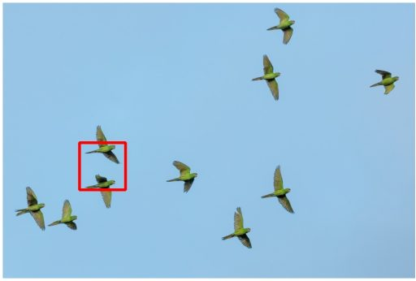
Template matching
Easy to make a mistake
BUT: it is a fast method
It has become faster with GPUs
Incorrect options can be avoided by DNNs

Slide 8
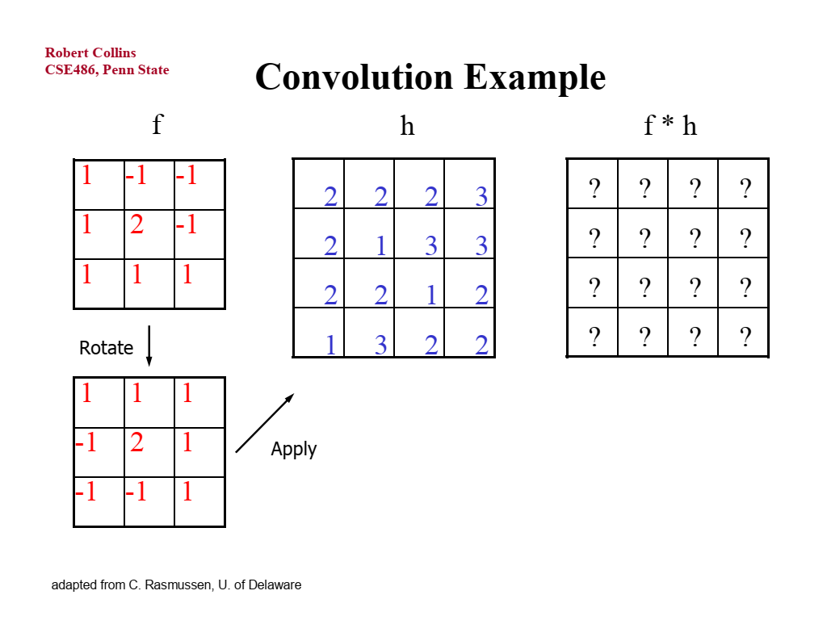

Slide 9
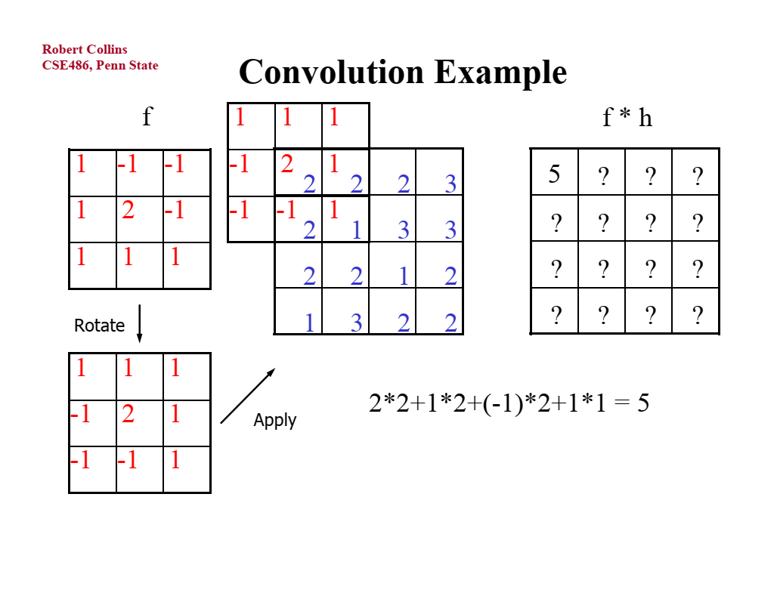

Slide 10
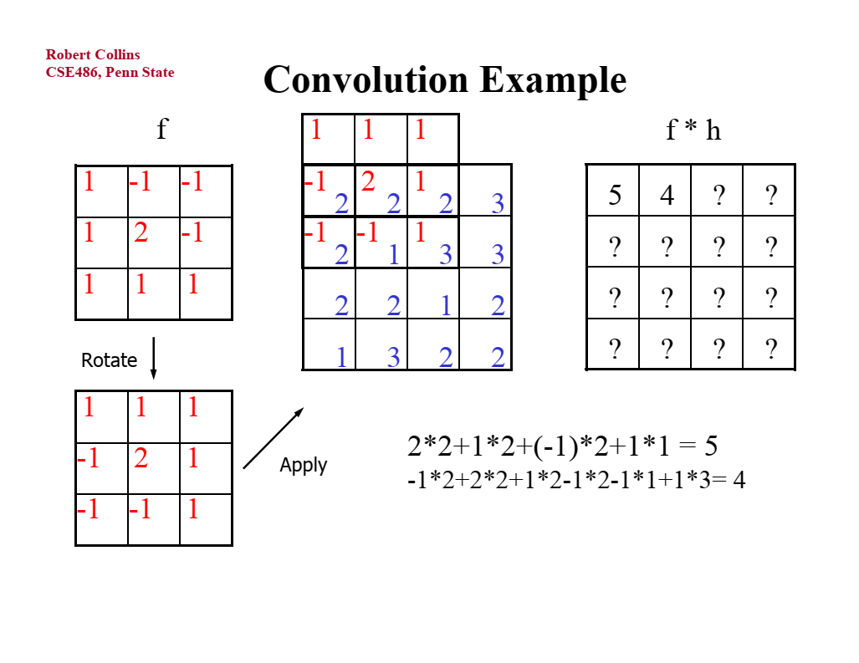

Slide 11
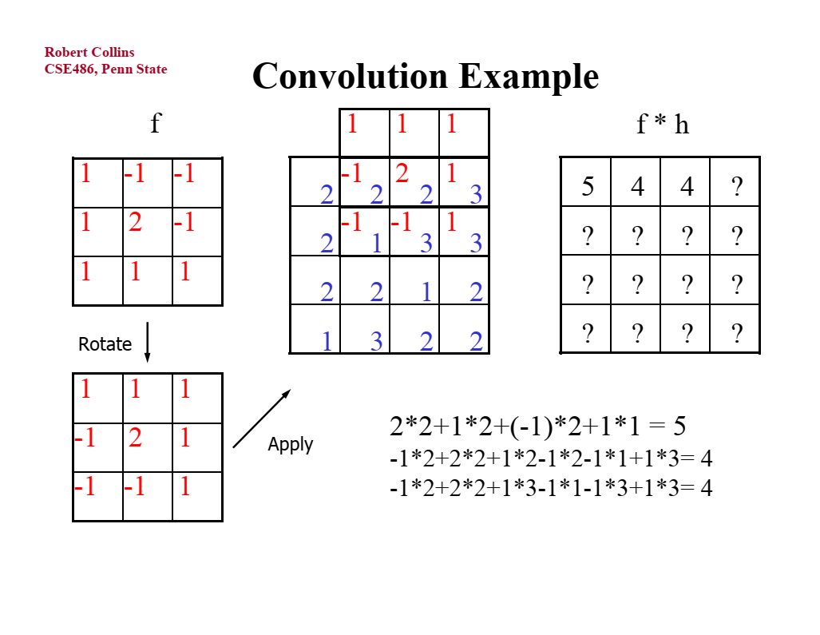

Slide 12
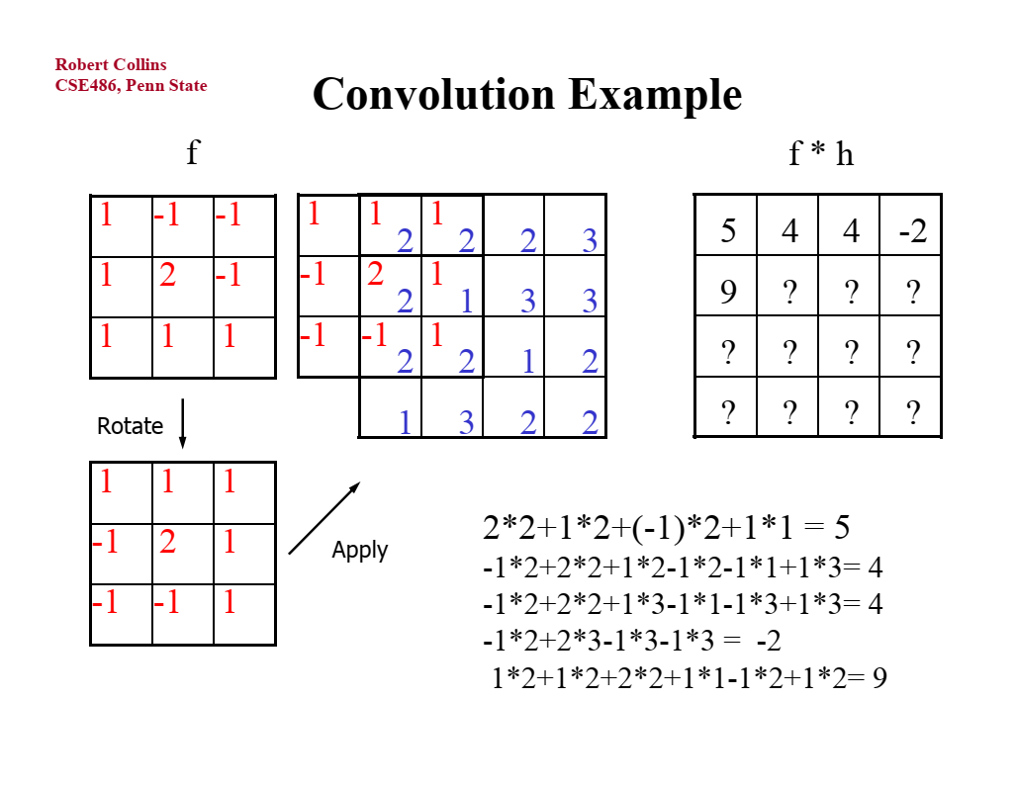

Slide 13
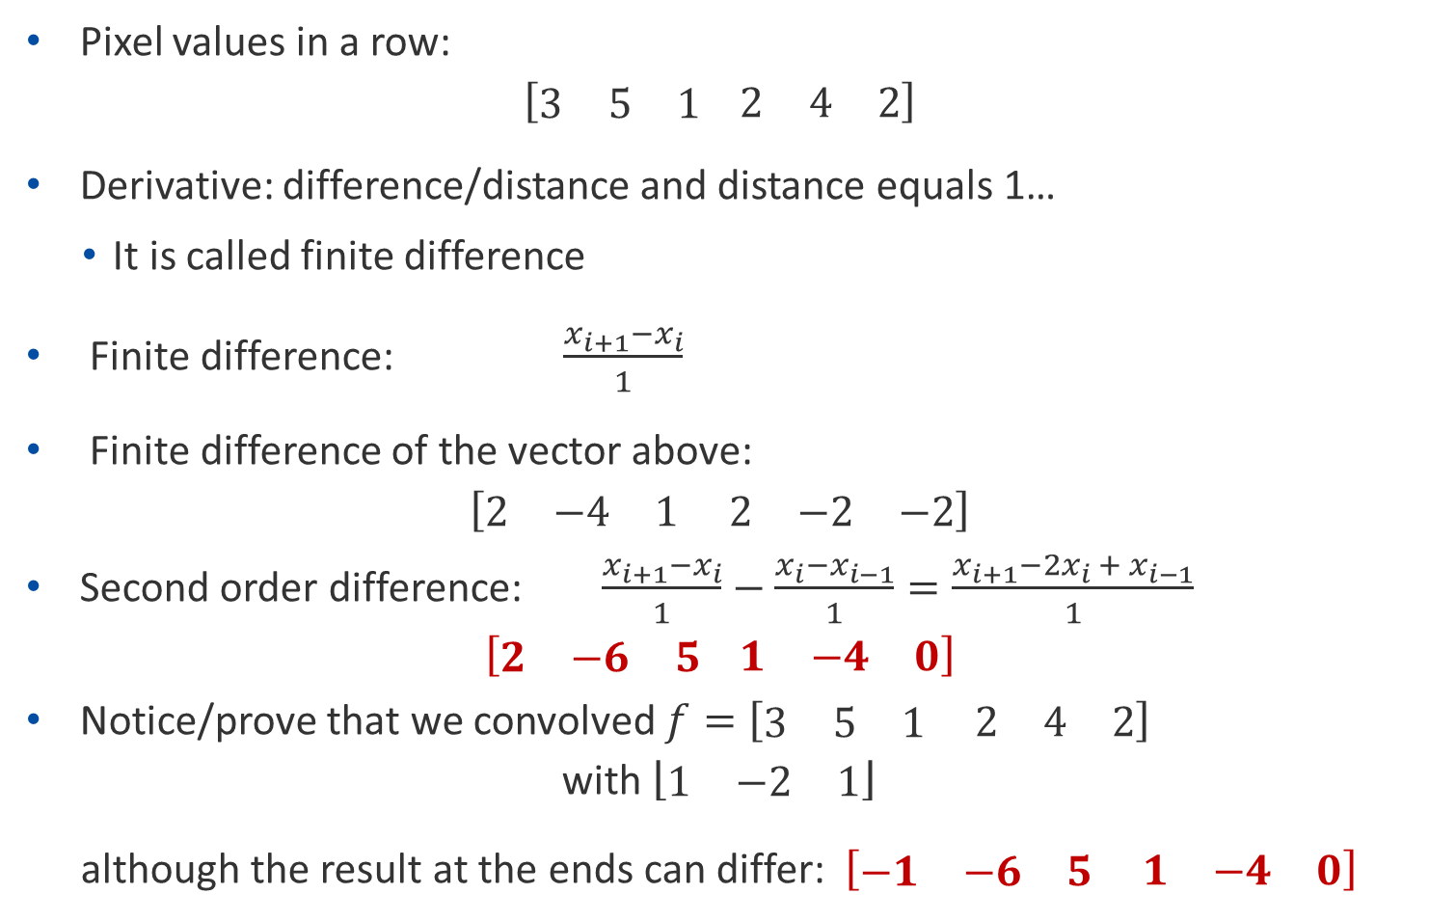
Derivative in 1D pixel space
Pixel values in a row:
$$\left[\begin{matrix}3 & 5 & 1\end{matrix} \begin{matrix}2 & 4 & 2\end{matrix}\right]$$
Derivative: difference/distance and distance equals 1…
It is called finite difference
Finite difference: $\frac{x_{i+1}−x_{i}}{1}$
Finite difference of the vector above:
$$\left[\begin{matrix}2 & −4 & 1\end{matrix} \begin{matrix}2 & −2 & −2\end{matrix}\right]$$
Second order difference: $\frac{x_{i+1}−x_{i}}{1}−\frac{x_{i}−x_{i−1}}{1}=\frac{x_{i+1}−{2x}_{i} + x_{i−1}}{1}$
$$\left[\begin{matrix}2 & −6 & 5\end{matrix} \begin{matrix}1 & −4 & 0\end{matrix}\right]$$
Notice/prove that we convolved $f=\left[\begin{matrix}3 & 5 & 1\end{matrix} \begin{matrix}2 & 4 & 2\end{matrix}\right]$
with $\left\lfloor \begin{matrix}1 & −2 & 1\end{matrix}\right\rfloor$
although the result at the ends can differ: $\left[\begin{matrix}−1 & −6 & 5\end{matrix} \begin{matrix}1 & −4 & 0\end{matrix}\right]$

Slide 14
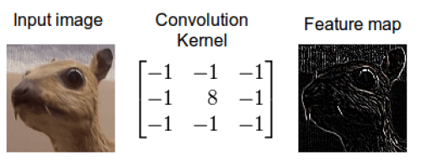
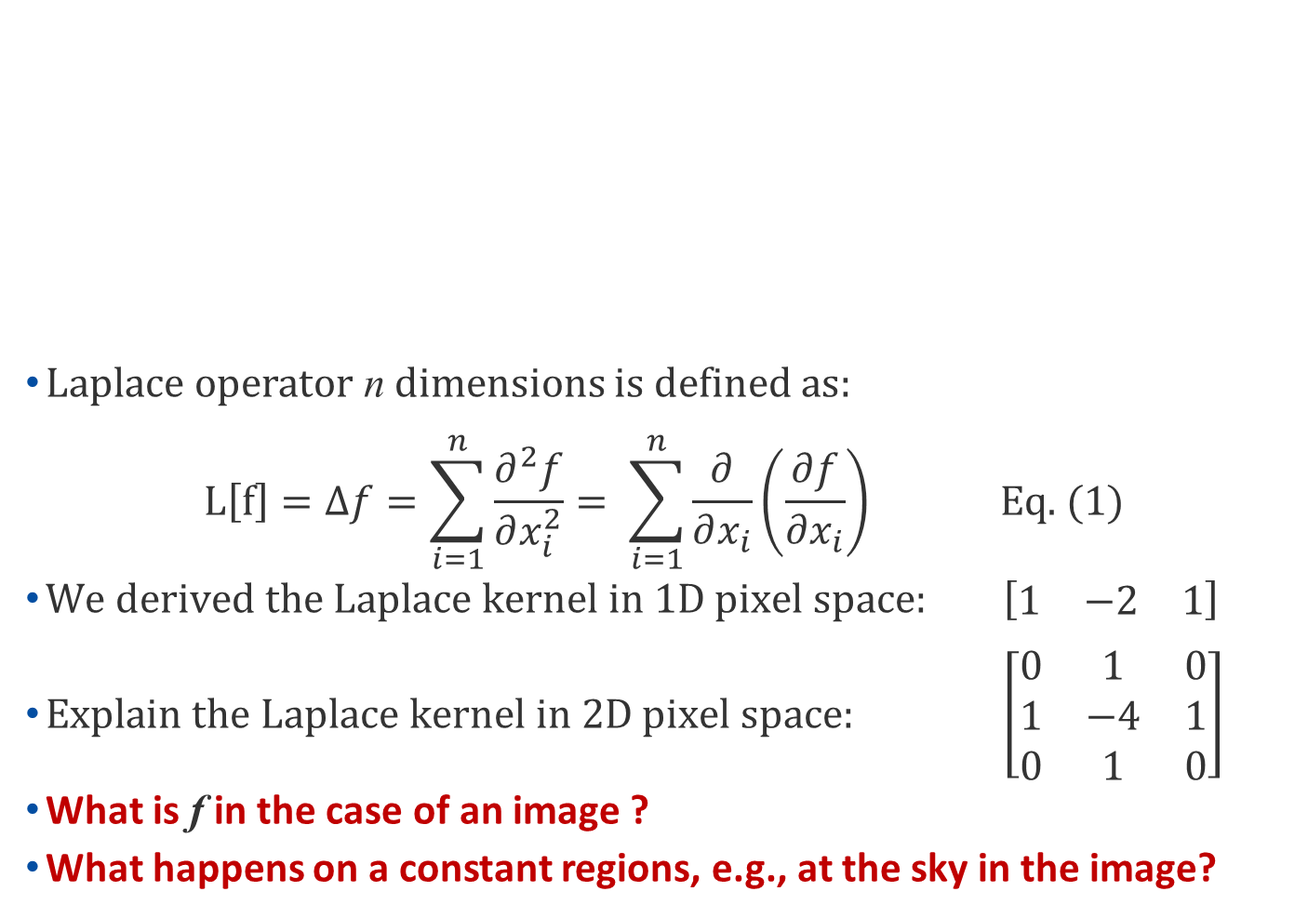
What can convolution do?
What is this?
Laplace operator n dimensions is defined as:
$$L\left[f\right]=∆f=\sum_{i=1}^{n}{\frac{∂^{2}f}{∂x_{i}^{2}}= \sum_{i=1}^{n}{\frac{∂}{∂x_{i}}\left(\frac{∂f}{∂x_{i}}\right)} \text{Eq}\text{. (1)}}$$
$\text{We} \text{derived} \text{the} \text{Laplace} \text{kernel} \text{in}\text{ 1}\text{D} \text{pixel} \text{space}\text{: }\left[\begin{matrix}1 & −2 & 1\end{matrix}\right]$
$\text{Explain} \text{the} \text{Laplace} \text{kernel} \text{in}\text{ 2}\text{D} \text{pixel} \text{space}\text{: } \left[\begin{matrix}0 & 1 & 0 \\ 1 & −4 & 1 \\ 0 & 1 & 0\end{matrix}\right]$
What is f in the case of an image ?
What happens on a constant regions, e.g., at the sky in the image?

Slide 15
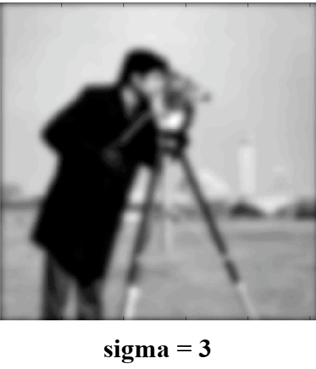
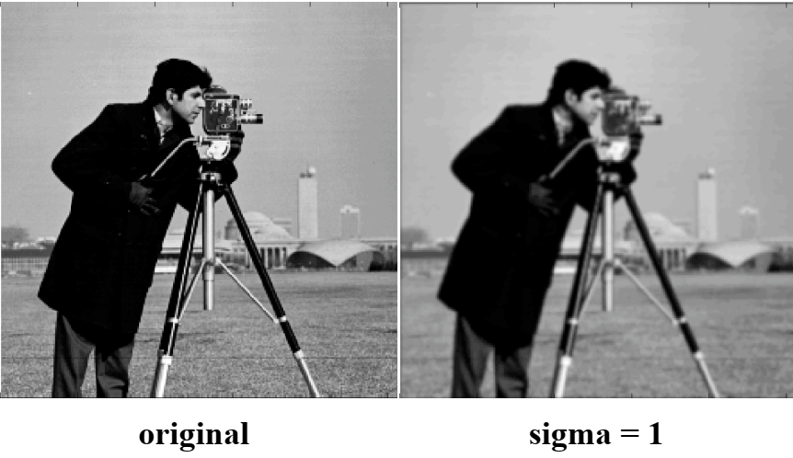
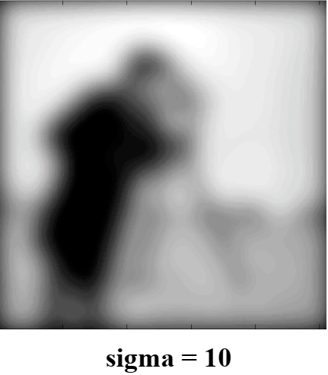
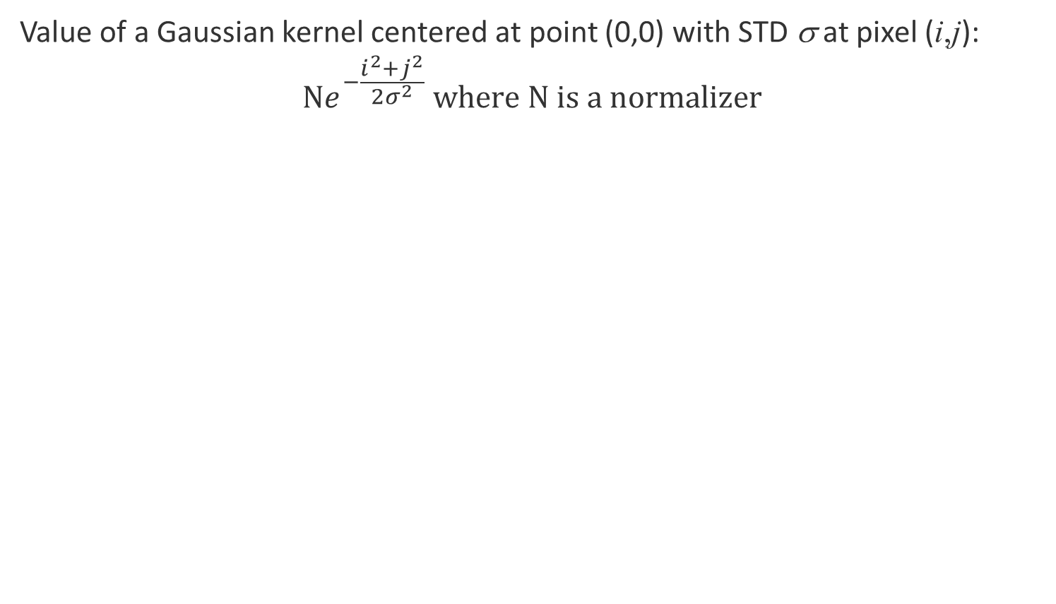
Blurring: Convolution with a 2D Gaussian
Value of a Gaussian kernel centered at point (0,0) with STD σ at pixel (i,j):
$${\text{N}e}^{−\frac{i^{2}+j^{2}}{2σ^{2}}} \text{where} \text{N} \text{is} \text{a} \text{normalizer}$$

Slide 16
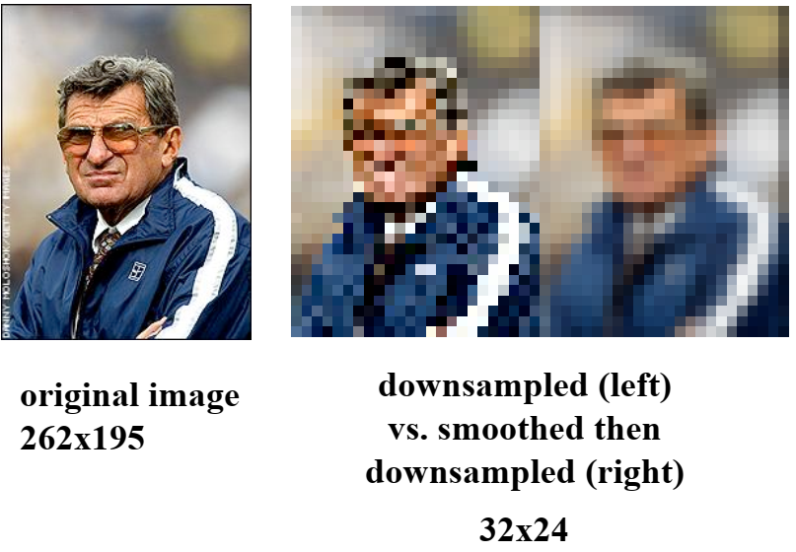
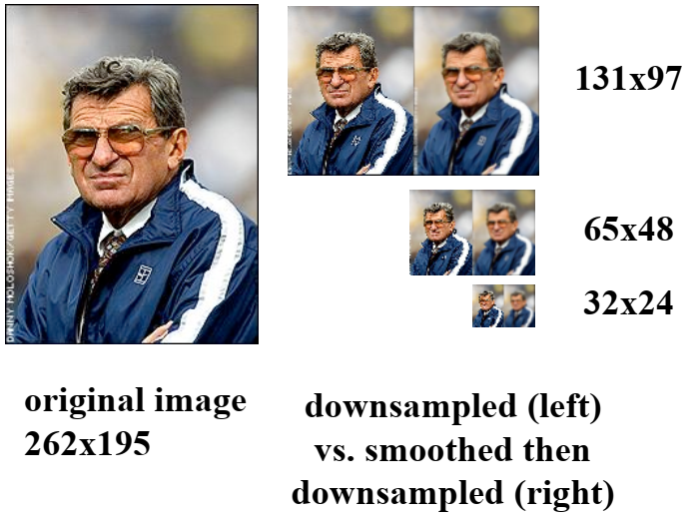
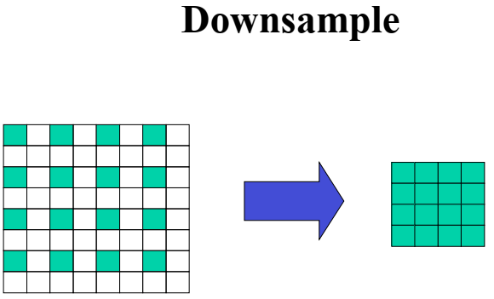
Gaussian and downsampling

Slide 17
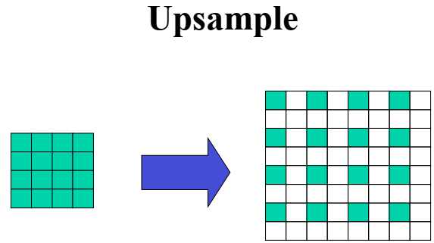
Upsampling:
relevant for convolutional autoencoders

Slide 18
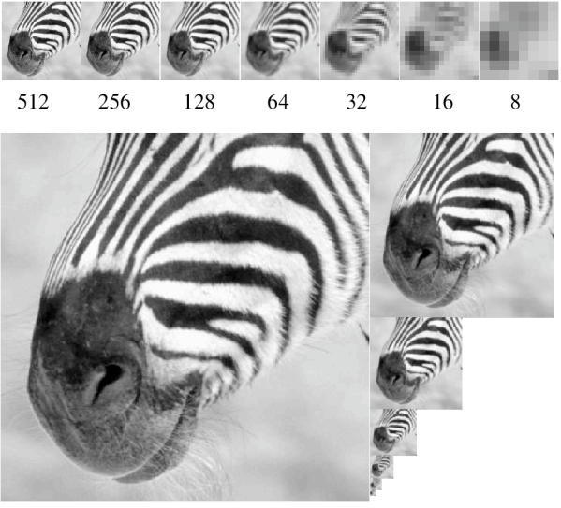
Recall: it can be reversed by superresolution

Slide 19
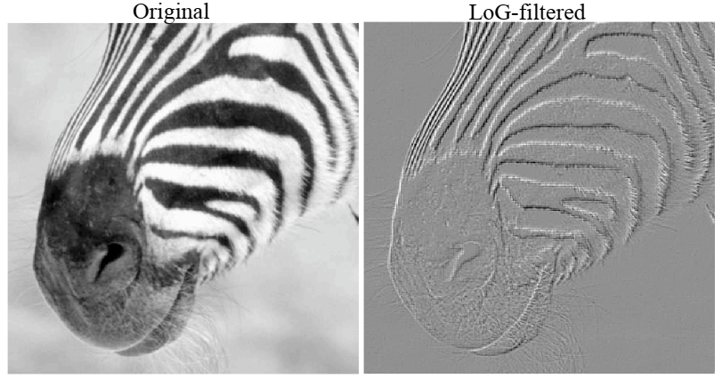
Many other versions: Laplacian of Gaussian
What is the Laplacian of Gaussian (LoG)?
Easy: f in Eq, (1) is the Gaussian function

Slide 20
What if we give up to design filters? Instead, we try to train the filters ”to do the job”.
Compute the cost of the improper job
Train to improve performance

Slide 21
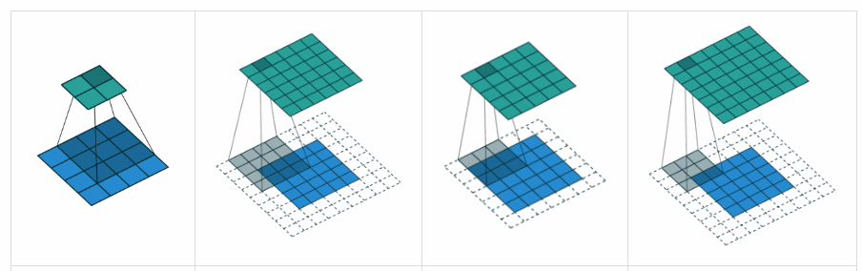
Basic layer: convolution

Slide 22
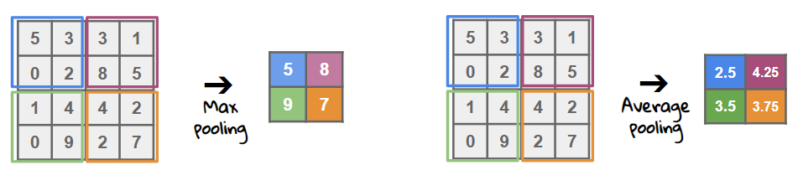
Basic layer: pooling

Slide 23
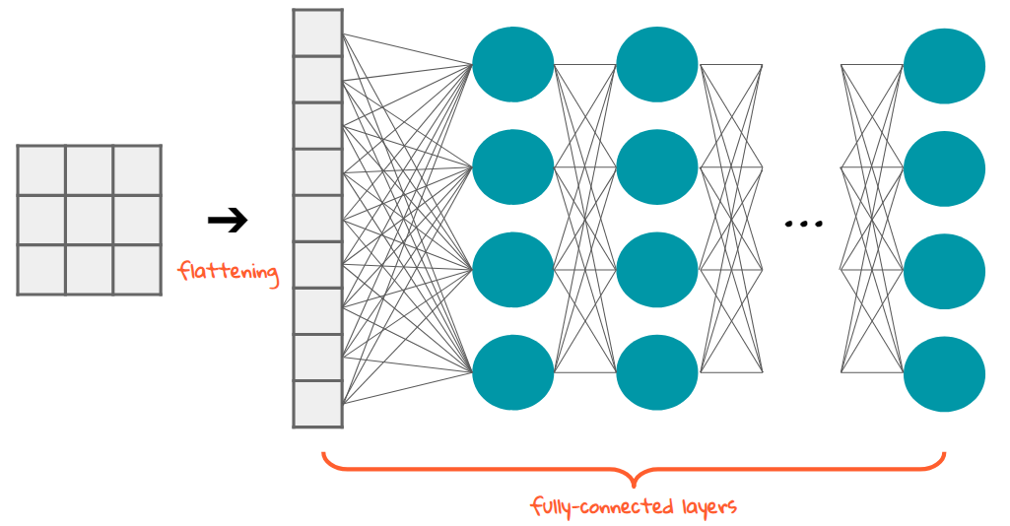
Basic layer: flattening

Slide 24
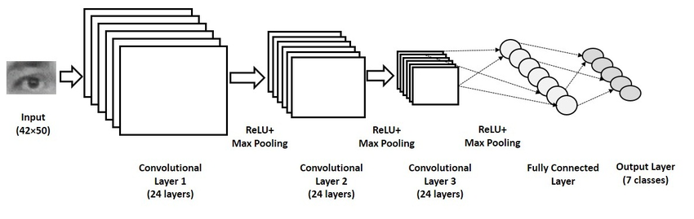
(Simple basic) CNN architecture
Unknown yet: ReLU

Slide 25
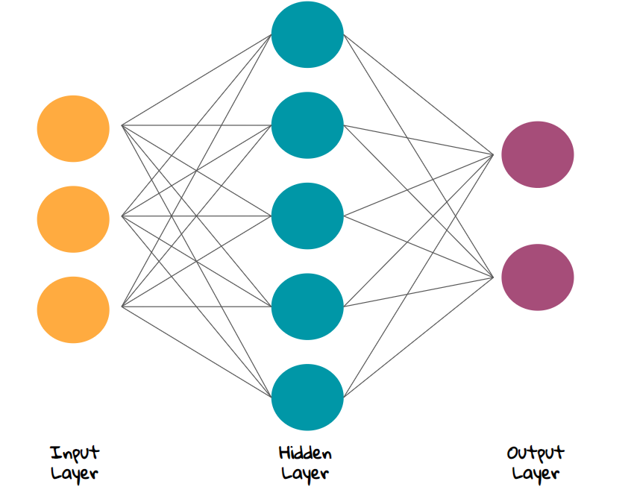
Convolutional Neural Networks
So:
CNNs are made of:
convolutional layers
pooling layers
dense layers
BUT:
What is a layer?
What can layers do?
Drawings are from here:
https://towardsdatascience.com/the-most-intuitive-and-easiest-guide-for-artificial-neural-network-6a3f2bc0eecb

Slide 26
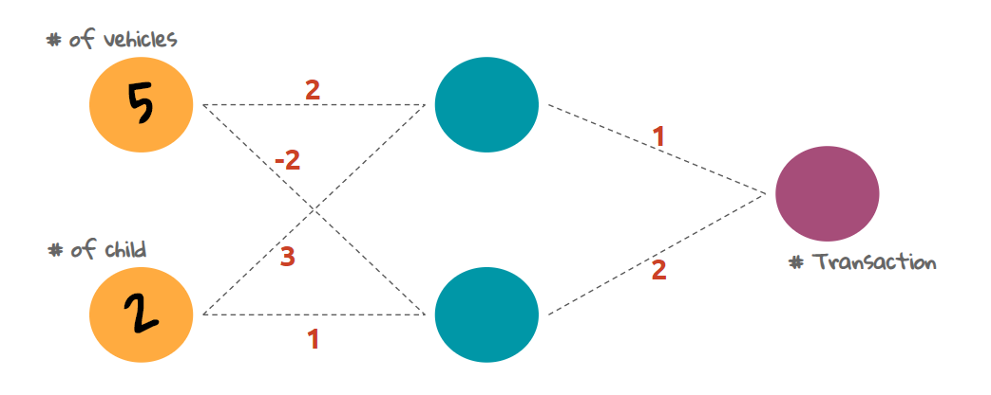
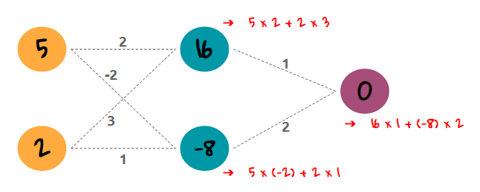
Weights and forward propagation

Slide 27
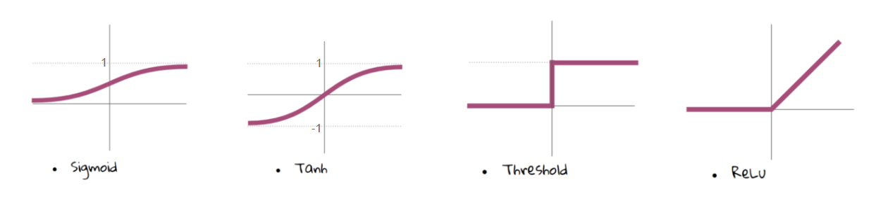
Activation functions

Slide 28
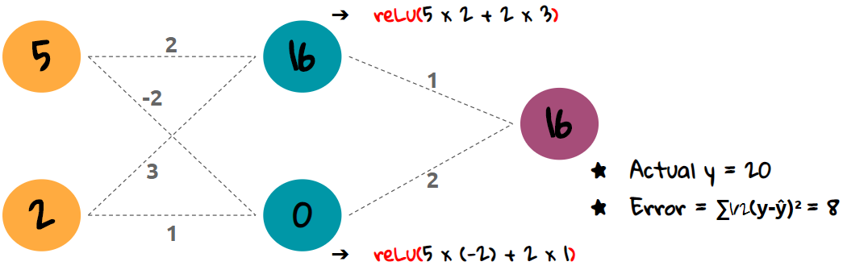
Weights and forward propagation
With ReLU

Slide 29
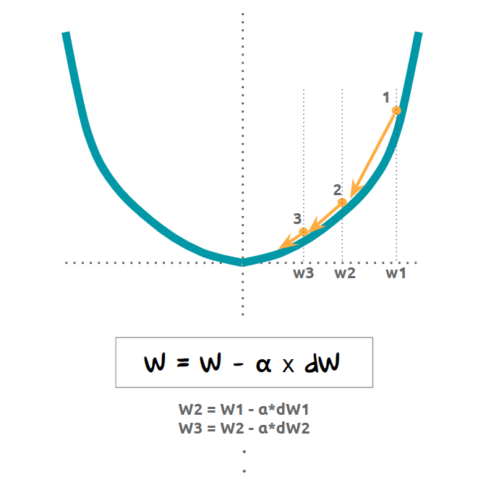
Training

Slide 30
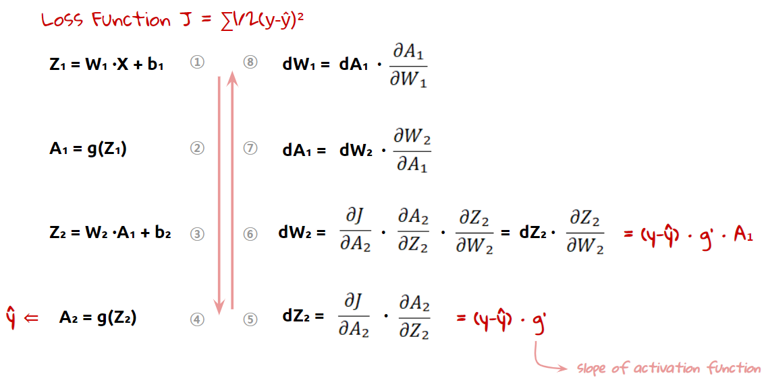
Differentiation: homework for ReLU...

Slide 31
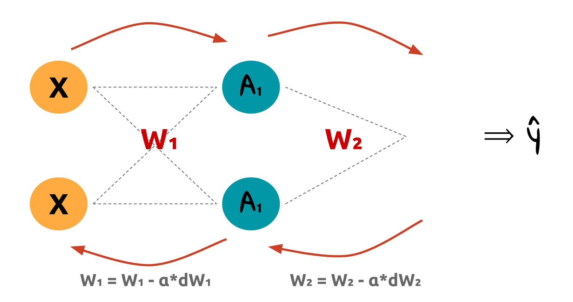
Repeat

Slide 32
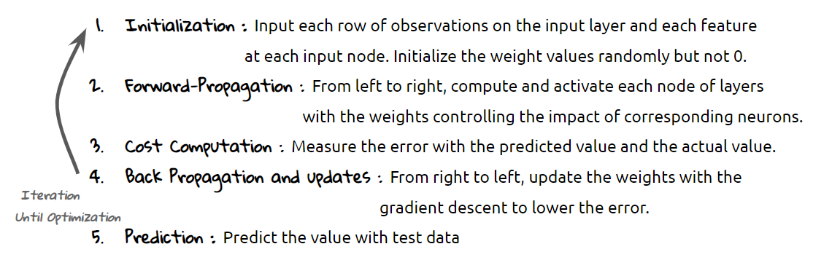
Summary

Slide 33

Rich arsenal of convolutional networks

Slide 34
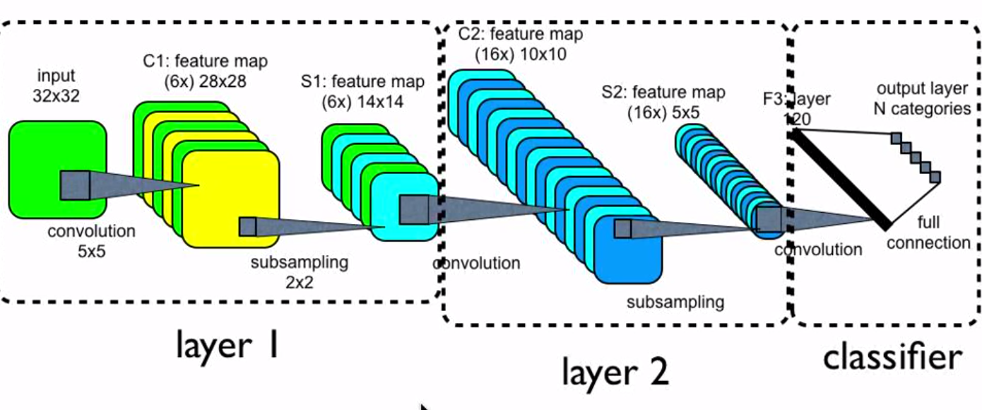
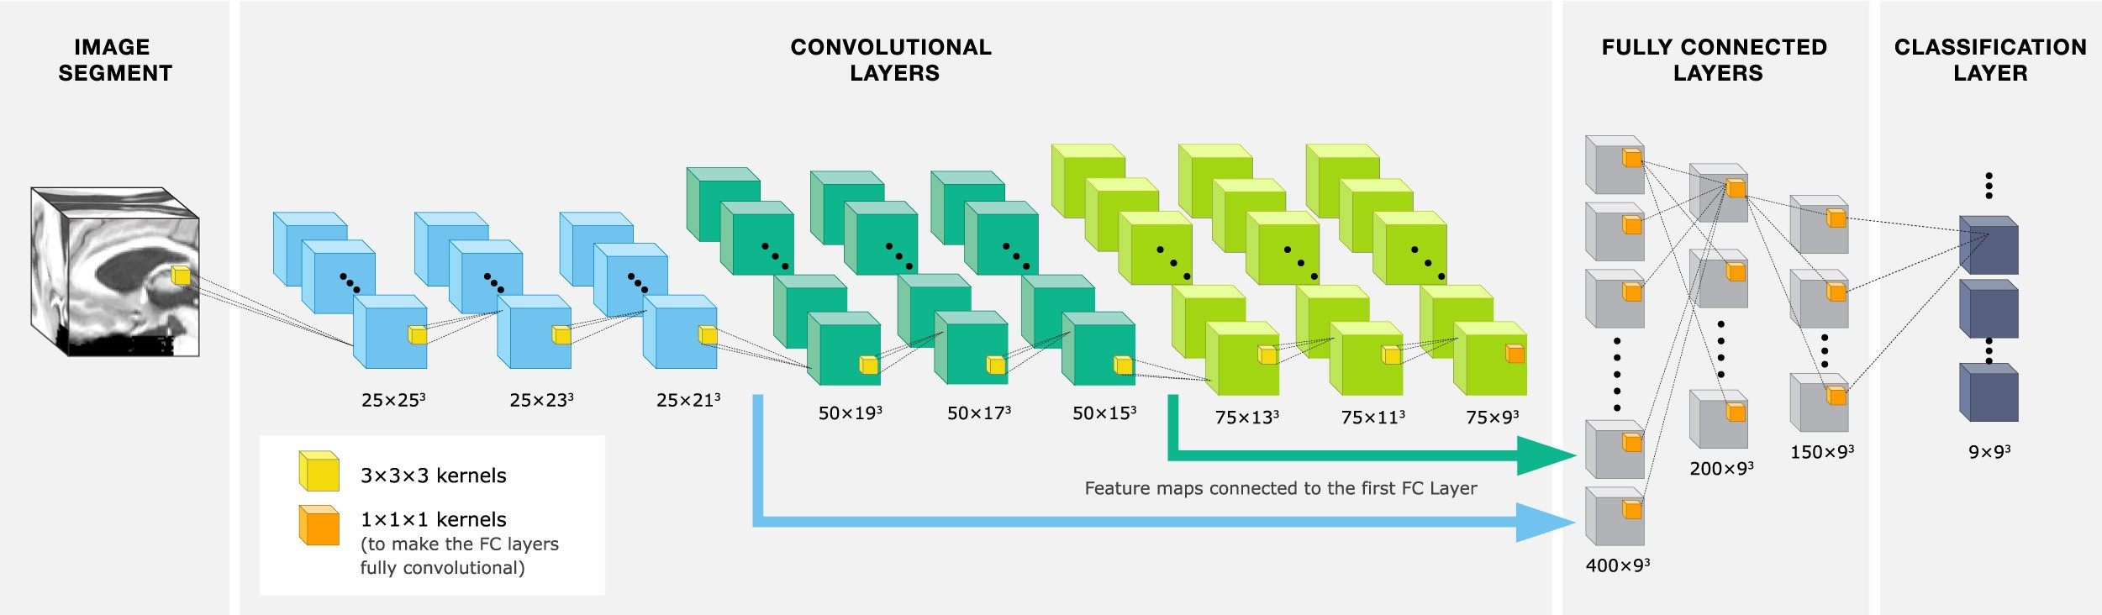
Rich arsenal of convolutional networks
2D convolutions
3D convolutions
??? 1D convolutions ???
https://towardsdatascience.com/understanding-1d-and-3d-convolution-neural-network-keras-9d8f76e29610
NOTE:
You can do 3D and thus you can do video

Slide 35
Demo 1: Style change network

Slide 36
Demo 2: Elimination from images

Slide 37
Demo 3: Elimination in video

Slide 38
Demo 4: Video retargeting

Slide 39
Some demos and options for home
Style Change: faces
https://www.youtube.com/watch?v=kSLJriaOumA
Create High Resolution GAN Faces with Pretrained NVidia StyleGAN and Google CoLab – https://www.youtube.com/watch?v=RPGOPrkieTE
Inpainting:
NVIDIA demo https://www.nvidia.com/research/inpainting/
https://www.youtube.com/watch?v=LIJPUsrwx5E
https://www.youtube.com/watch?v=RtThGNTvkjY

Slide 40
Note: Since we have learned a 3D model of the world, it is easy to create illusions

Slide 41
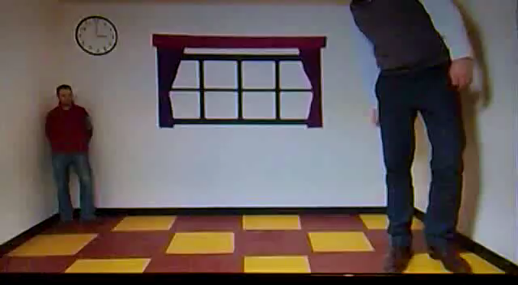
Easy to cheat you...

Slide 42
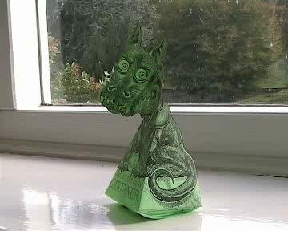
Easy to cheat you...

Slide 43
Thank you
for your
attention!
lorincz@inf.elte.hu

Slide 44
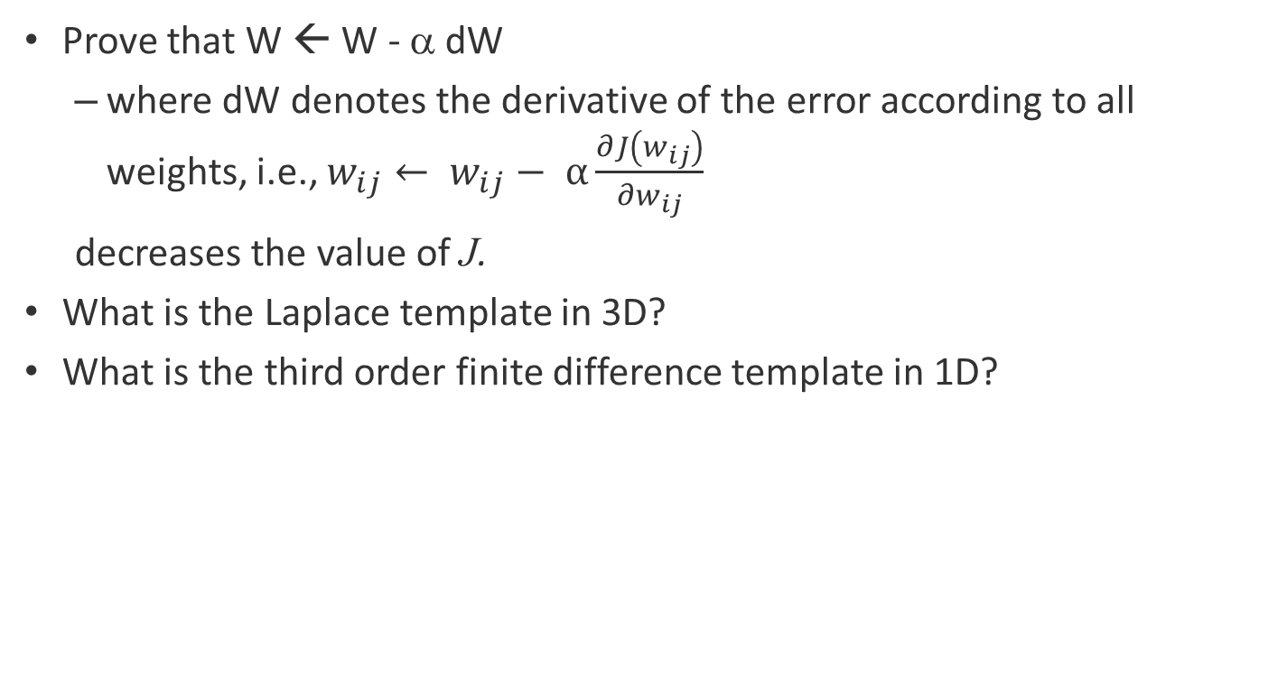
Homeworks
Prove that W ← W - α dW
where dW denotes the derivative of the error according to all weights, i.e., $w_{ij}← w_{ij}− α\frac{∂J\left(w_{ij}\right)}{{∂w}_{ij}}$
decreases the value of J.
What is the Laplace template in 3D?
What is the third order finite difference template in 1D?

Slide 45
Some issues that you may be asked about
Expect similar ones as well…
What is called template matching on an image?
What is a convolutional network made of?
What is the convolution in the convolutional network?
Tell four elementary convolutional examples!
What is a template?
What does the template do?
What is blurring?
What is a Gaussian blurring?
What is downsampling (or subsampling)?
What is upsampling?
What is upsampling used for?
What is pooling?
Tell three examples for pooling! What are they good for?
What is flattening?
What is a non-linearity?
Can thresholding be seen as a non-linarity?
What is a rectified unit?
Tell examples for cases that may involve 1, 2, 3, and 4 dimensional convolutions!

